Slide 1
Infrastructure Services
By
Jitendra Singh Tomar || Jeetu

Slide 2
Topics to discuss
What Are Infrastructure Services?
What if businesses do not have an IT infra?
Trending Infrastructures
Redefining Infrastructures
Typical infrastructure services in a datacenter
Compute Service
Hypervisor & its types
Storage Services & its advantages
Network Services & its type
Content Delivery Network (CDN)

Slide 3
What Are Infrastructure Services?
Infrastructure includes Networking equipment, Servers and Storage due to the important function they provide within specific business environments.
Infrastructure services include communication services, networking, data processing and storage, platforms through which businesses can share content and media, knowledge management, systems, applications, IoT, user devices, resilience.

Slide 4
What if businesses do not have an IT infra?
Businesses struggle to share and move data in an efficient way within the workplace.
And when IT infrastructure fails, many business functions are not able to be performed.

Slide 5
Trending Infrastructures
Automation.
Hybrid IT vs. disaster recovery
Scaling DevOps agility
Distributed cloud
Containerization
Artificial intelligence
IoT

Slide 6
Redefining Infrastructures
Infrastructure services in a data center refer to the foundational components and resources that support the operations of information technology (IT) systems and applications.
These services provide the essential hardware, networking, and other resources necessary for the functioning of a data center.

Slide 7
Typical infra services in a data center
Compute Services
Storage Services
Network Services
Power and Cooling Services
Management and Monitoring Services
Security Services
Collaboration and Communication Services
Scalability and Resource Orchestration
Compliance and Governance Services
Cloud Services Integration

Slide 8
Compute Services
Compute services are also known as Infrastructure-as-a-Service (IaaS).
Compute platforms supply a virtual server instance and storage to work.
Users have allocated compute power and can start, stop, access, and configure their computer resources as desired.
Types:
Physical or Virtual Machines
Virtualization (Hypervisor-based).

Slide 9
What is a Hypervisor?

Slide 10
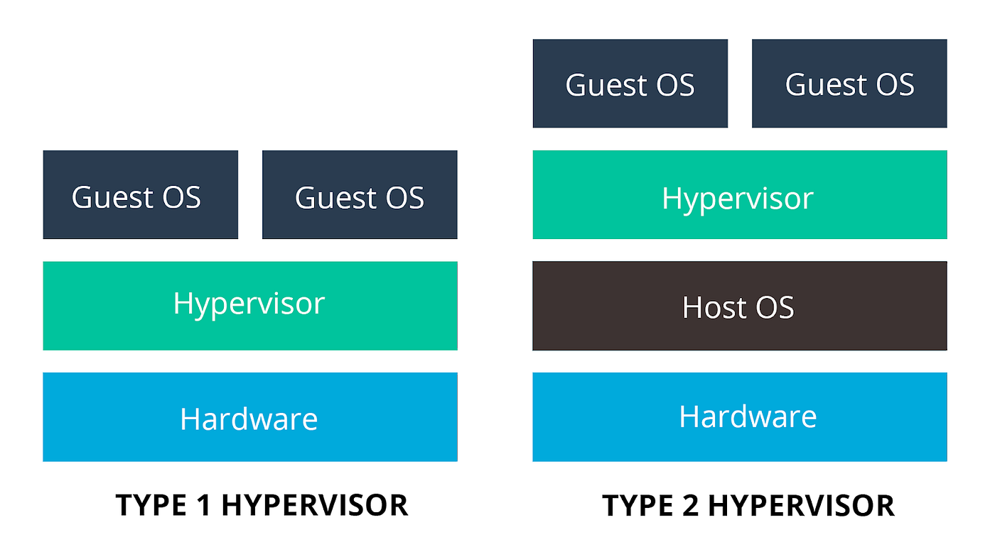
Types of Hypervisor

Slide 11
Type 1 Hypervisor
A.K.A Bare Matel Hypervisor
Example:
VMWare ESXi
Citrix Xen Server
Microsoft Hyper-V
Oracle VM Server

Slide 12
Type 2 Hypervisor
A.K.A Guest-based O.S Hypervisor
Example:
Microsoft Virtual PC.
Oracle Virtual Box.
VMware Workstation.
Oracle Solaris Zones.
VMware Fusion.
Oracle VM Server for x86.
CentOS Virtualization.

Slide 13
Examples of IAAS
AWS
Azure
Cloud stack
Citrix cloud
Google Cloud Platform
OpenStack
Oracle Cloud
Rackspace cloud
Virtual Private Cloud

Slide 14
Storage Services
Storage as a service is a managed service in which the provider supplies the customer with access to a data storage platform.
Storage as a service was originally seen as a cost-effective way for small and mid-size businesses that lacked the technical personnel and capital budget to implement and maintain their own storage infrastructure.
Typical offerings include
bare-metal storage capacity
raw storage volumes
network file systems
storage objects
storage applications that support file sharing and backup lifecycle management.

Slide 15
Advantages of Storage Services
Storage costs. Personnel, hardware and physical storage space expenses are reduced.
Disaster recovery. Having multiple copies of data stored in different locations can better enable disaster recovery measures.
Scalability. With most public cloud services, users only pay for the resources that they use.
Syncing. Files can be automatically synced across multiple devices.
Security. Security can be both an advantage and a disadvantage, as security methods may change per vendor.

Slide 16
Examples of Storage Service
Amazon Web Services (AWS)
Microsoft Azure
Google Cloud
Oracle cloud
Box
Storage Area Network (SAN)
Network-Attached Storage (NAS)
NFS
Data Backup & Recovery

Slide 17
Network Attached Storage (NAS)
NAS is a type of storage device that is connected to a network and provides centralized data access and file sharing to various clients or users.
NAS systems are independent devices with their own operating systems and file management capabilities.
A NAS device is simply a container for hard drives with some additional intelligence included for files to be shared and authorized.

Slide 18
Benefits of NAS
Speed
Control
Ease of use
Reliable access

Slide 19
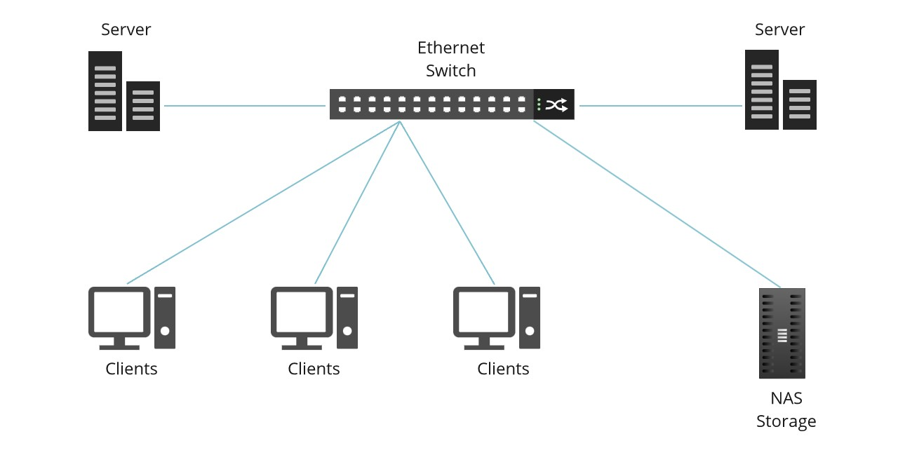
Network Attached Storage

Slide 20
Storage Area Network (SAN)
SAN is a network of storage devices that can be accessed by multiple servers or computers, providing a shared pool of storage space.
Each computer on the network can access storage on the SAN as though they were local disks connected directly to the computer.
It's like a highway for data, allowing servers to access storage resources as if they were directly attached, even if they're physically located elsewhere.

Slide 21
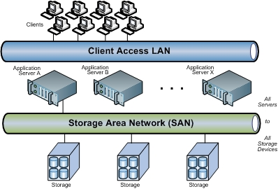
Storage Area Network (SAN)

Slide 22
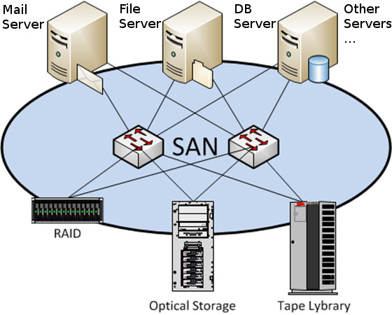
Storage Area Network (SAN)

Slide 23
Components of SAN
There are 3 major components of SAN.
Server
Network Infrastructure
Storage

Slide 24
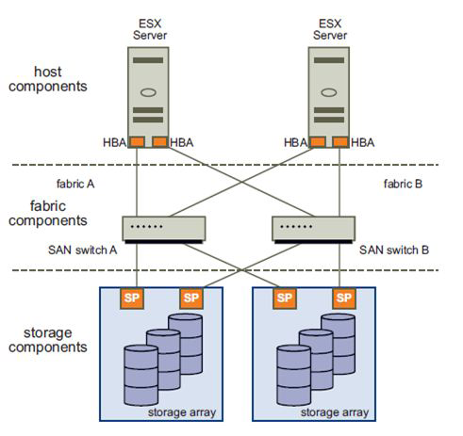
SAN Components
SAN switches
SAN fabric
Physical Disk
Connections
Host Bus Adapter (HBA)
Controllers
RAID Group

Slide 25
Network Services
Network services are applications at the network application layer that connect users working in offices, branches, or remote locations to applications and data in a network.
Network as a service (NaaS) is a cloud model that lets organizations easily operate their networks and achieve the outcomes they expect from them without owning, building, or maintaining infrastructure themselves.

Slide 26
Types of network services
Internet and cloud connectivity
Branch office and campus connectivity
Private data center services
Secure cloud-connectivity services
Virtual network services

Slide 27
Content Delivery Network (CDN)
A content delivery network (CDN) is a geographically distributed group of servers that caches content close to end users.
A CDN allows for the quick transfer of assets needed for loading Internet content, including HTML pages, JavaScript files, stylesheets, images, and videos.

Slide 28
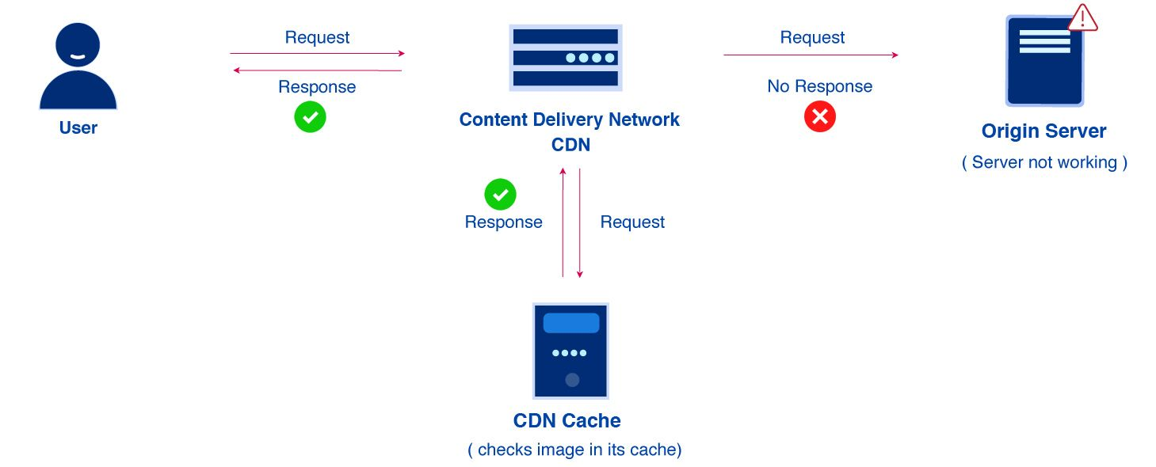
Content Delivery Network (CDN)

Slide 29
Services in action
Switching and Routing
Networking infrastructure to enable communication between servers, storage, and other devices.
Load Balancing
Distributing network traffic across multiple servers to ensure optimal resource utilization and high availability.

Slide 30
Services in action
Firewall and Security
Implementing security measures to protect against unauthorized access and cyber threats.
Intrusion Detection and Prevention Systems (IDPS)
Monitoring and preventing security threats within the network.

Slide 31
Power and Cooling Services
Uninterruptible Power Supply (UPS)
Power Distribution Units (PDUs)
Cooling Systems

Slide 32
Uninterruptible Power Supply (UPS)
A device that provides battery backup and surge protection to connected electronic devices.
Key features of a UPS include:
Battery Backup
Surge Protection
Voltage Regulation
Automatic Voltage Regulation (AVR)
Monitoring and Management
Different Form Factors

Slide 33
Power Distribution Units (PDUs)
PDU is a device designed to distribute electric power to multiple devices within a data center, server room, or other environments where many electronic devices are present.
PDUs play a crucial role in managing and controlling the power supply to various equipment efficiently.

Slide 34
PDU Features
Power Distribution
Mounting Options
Input and Output Connections
Types of PDUs:
Basic PDUs
Metered PDUs
Switched PDUs
Monitored and Managed PDUs
Monitoring and Management
Redundancy
Environmental Monitoring

Slide 35
Data Center Infrastructure Management
Data center infrastructure management (DCIM) tools monitor, measure, manage and/or control data center utilization and energy consumption of all IT-related equipment (such as servers, storage and network switches) and facility infrastructure components (such as power distribution units [PDUs] and computer room air conditioners [CRACs])

Slide 36
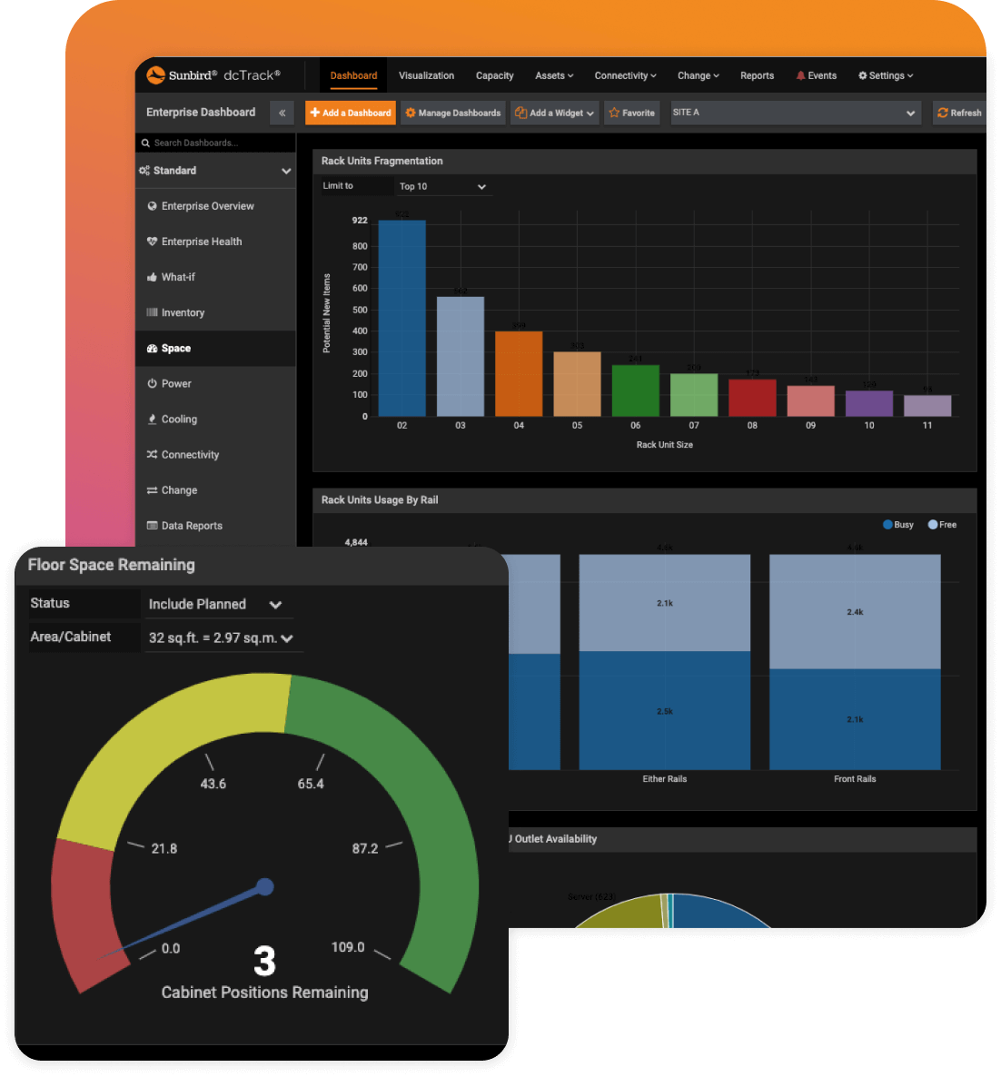
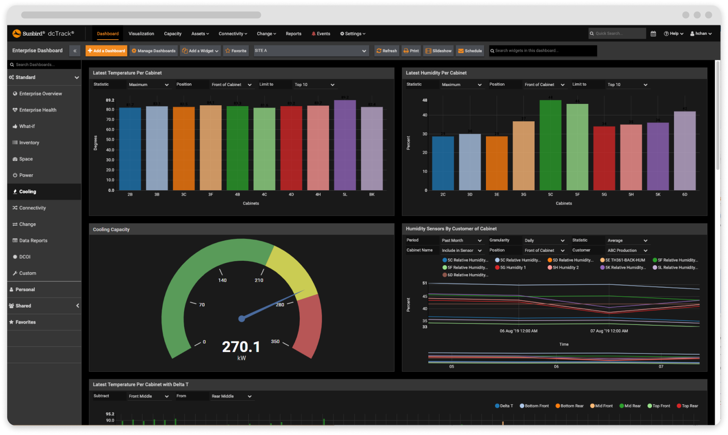
DCIM Tool

Slide 37
DCIM Benefits
Improve Uptime
Improve capacity planning & Utilization
Increase energy efficiency
Improve People Productivity

Slide 38
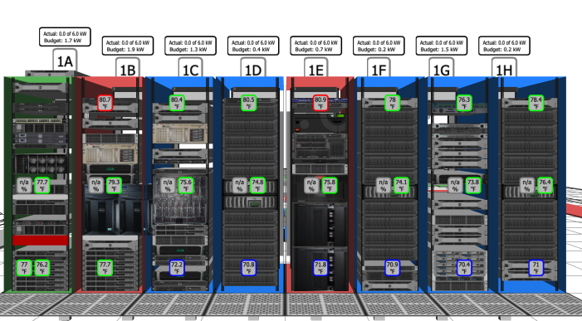
Examples of DCIM Software
Sunbird DCIM
Intel Data Center Manager (DCM)
Device42
Rackwise DCiM X
Emerson Network Power Trellis
Virtana
RF Code CenterScape
Cormant-CS DCIM

Slide 39
Remote Infrastructure Management (RIM)
RIM is a comprehensive approach to handling and overseeing an organization's IT infrastructure, systems and services from a remote location.
It typically involves the use of advanced technologies, automation and specialized service providers to monitor, manage and maintain IT infrastructure, ensuring optimal performance, security and reliability.

Slide 40
Why is RIM important?
Cost savings
Improves focus on core competencies.
Efficient handling of remote locations.
Reduce downtime and enhanced productivity

Slide 41
The benefits of RIM
Increased Productivity and Efficiency
Cost Reduction
Enhanced Monitoring and Proactive Maintenance
Scalability
Improved Work-Life Balance
Security and Compliance
Disaster Recovery
Customer Satisfaction

Slide 42
RIM Tools
Microsoft Remote Desktop
TeamViewer
Cisco Meraki Dashboard
Zabbix
HPE iLO (Integrated Lights-Out)
Dell iDRAC (Integrated Dell Remote Access Controller)
AWS Management Console
Microsoft Azure Portal
Google Cloud Console
Trend Micro Office Scan
And Many More…

Slide 43
Performance Monitoring
IT performance management is the supervision of an organization's IT infrastructure to ensure key performance indicators, service levels and budgets comply with the organization's goals.
IT performance management involves purchasing decisions, standardization of IT equipment, and guidance on capital and human resources.

Slide 44
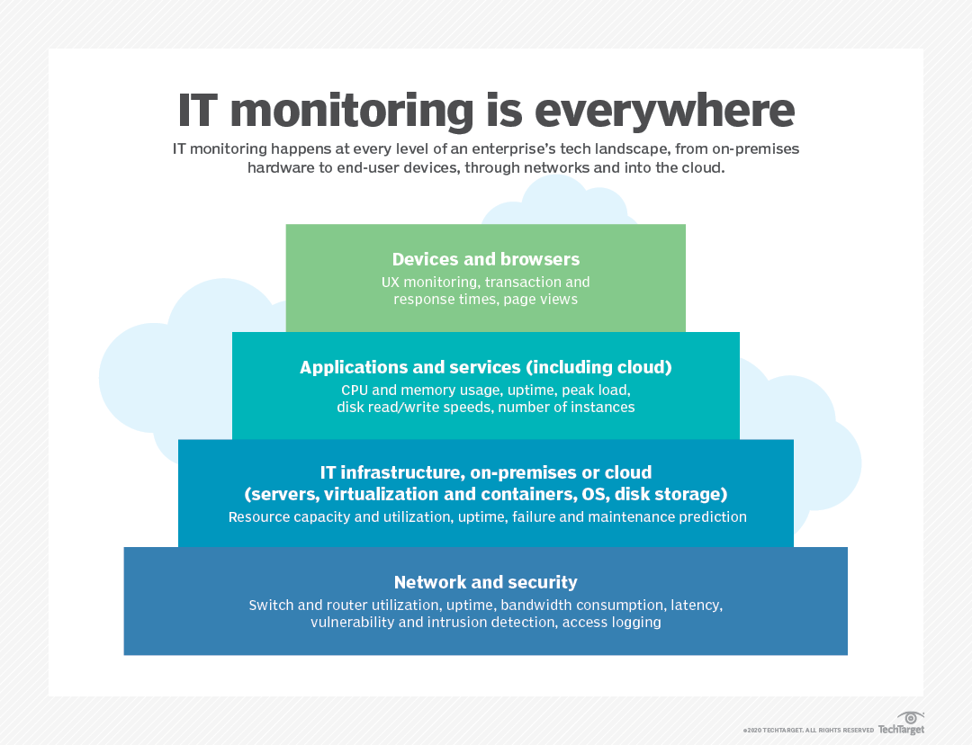

Slide 45
Performance Monitoring Tools
SolarWinds Server & Application Monitor (SAM)
NagiosXI
Wireshark
New Relic
AppDynamics
SolarWinds Database Performance Analyzer (DPA)
VMware vRealize Operations
Microsoft Hyper-V Manager
DataDog
AWS CloudWatch
Google PageSpeed Insights
Prometheus
Grafana
Open Hardware Monitor

Slide 46
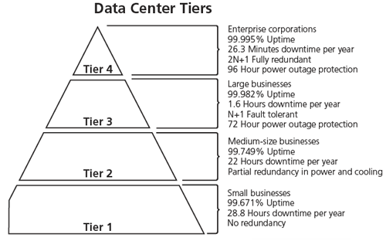
Physical Security - Data Centre tiers

Slide 47
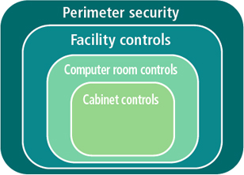
Security in data centre
Perimeter security,
Facility controls,
Computer room controls, and
Cabinet controls.

Slide 48
Best practices
Conduct regular audits
Strengthen access control systems
Enhance video surveillance

Slide 49
Network Security
Network security is essential to help protect sensitive corporate information, guard against data theft, monitor the network for vulnerabilities, mitigate threats, and ensure compliance with ever-changing regulations and standards.

Slide 50

Network Security
Cyberattacks are increasingly sophisticated and may involve the following techniques:
Packet sniffing
IP spoofing
Denial-of-service (DoS) attack
Password attack
Man-in-the-middle attack
Application attack
Port redirection attack

Slide 51
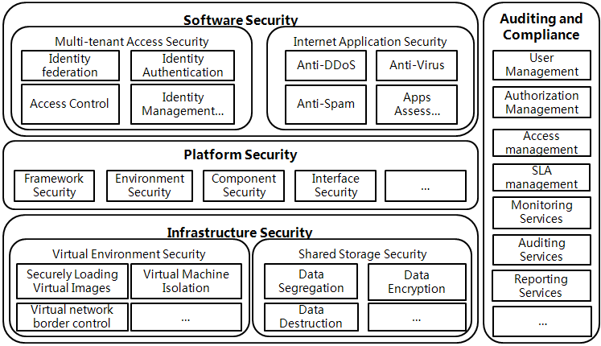
Cloud Computing Security Architecture

Slide 52
Security Services
Network Security
Endpoint Security
Identity & Access Management (IAM)
Security Information and Event Management (SIEM)
Cloud Security
Data Encryption Service
Web Security
Incident response & forensics
Security Awareness
Physical Security Services
Penetration Testing and Vulnerability Assessment

Slide 53
Security Services - Network Security
Firewall Services: Implementation and management of firewalls to control and monitor network traffic.
Intrusion Prevention Systems (IPS): Detection and prevention of malicious activities within the network.
Virtual Private Network (VPN): Securely connects remote users or networks over the internet.

Slide 54
Security Services - Endpoint Security
Antivirus and Anti-Malware Services: Protection against viruses, malware, and other malicious software on individual devices.
Endpoint Detection and Response (EDR): Monitors and responds to suspicious activities on endpoints.

Slide 55
Security Services - IAM
Single Sign-On (SSO): Allows users to access multiple systems with a single set of credentials.
Authentication Services: Verifies the identity of users or devices before granting access.
Authorization Services: Manages permissions and access rights based on user roles and responsibilities.

Slide 56
Security Services - SIEM
Log Management: Collects, analyzes, and stores logs from various IT systems for security monitoring.
Security Analytics: Utilizes machine learning and analytics to identify security incidents.

Slide 57
Security Services – Cloud Security
Cloud Access Security Broker (CASB): Monitors and enforces security policies for data in the cloud.
Security Orchestration, Automation, and Response (SOAR): Automates and coordinates security processes in cloud environments.

Slide 58
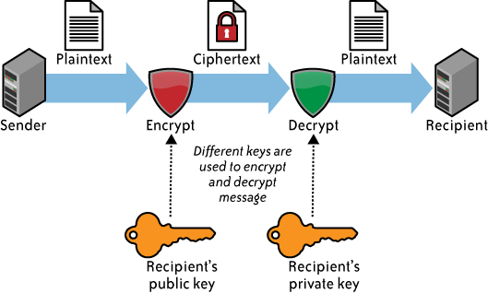
Security Services – Data Encryption
Data at Rest Encryption: Protects stored data from unauthorized access.
Data in Transit Encryption: Secures data as it travels between devices or across networks.

Slide 59
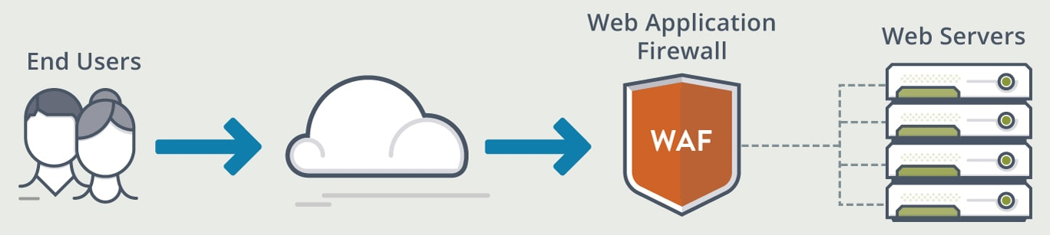
Security Services – Web Security
Web Application Firewall (WAF): Protects web applications from common web exploits and attacks.
Content Filtering: Controls access to web content based on policies and rules.

Slide 60

Security Services – Incident Response and Forensics
Incident Response Services: Helps organizations respond to and recover from security incidents.
Digital Forensics: Investigates and analyzes digital evidence related to security incidents.

Slide 61
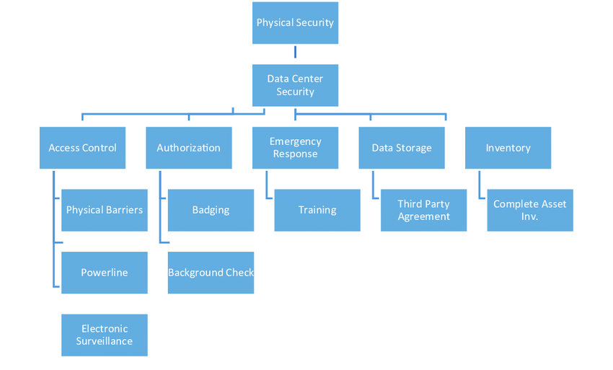
Security Services – Physical Security
Access Control Systems: Manages physical access to facilities and data centers.
Surveillance Systems: Monitors and records activities in physical spaces.

Slide 62
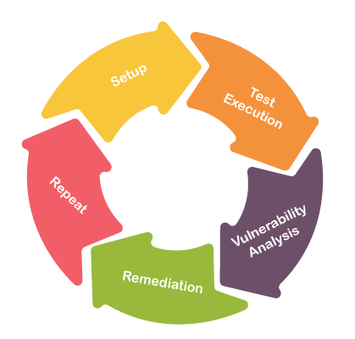
Security Services – Penetration Testing and Vulnerability Assessment
Penetration Testing Services: Simulates cyber-attacks to identify vulnerabilities and weaknesses.
Vulnerability Assessment Services: Regularly scans systems for known vulnerabilities.

Slide 63
Collaboration Services
Email Service
Deploying email platforms for internal communication, notifications, and collaboration among data center staff.
Real-time messaging platforms for quick and informal communication between team members.
Instant Messaging (IM)

Slide 64
Collaboration Services
Document Management Systems
Platforms for storing, organizing, and sharing documents securely within the data center team.
Centralized repositories of information, documentation, and best practices accessible to the data center staff.
Knowledge Base and Wiki Systems

Slide 65
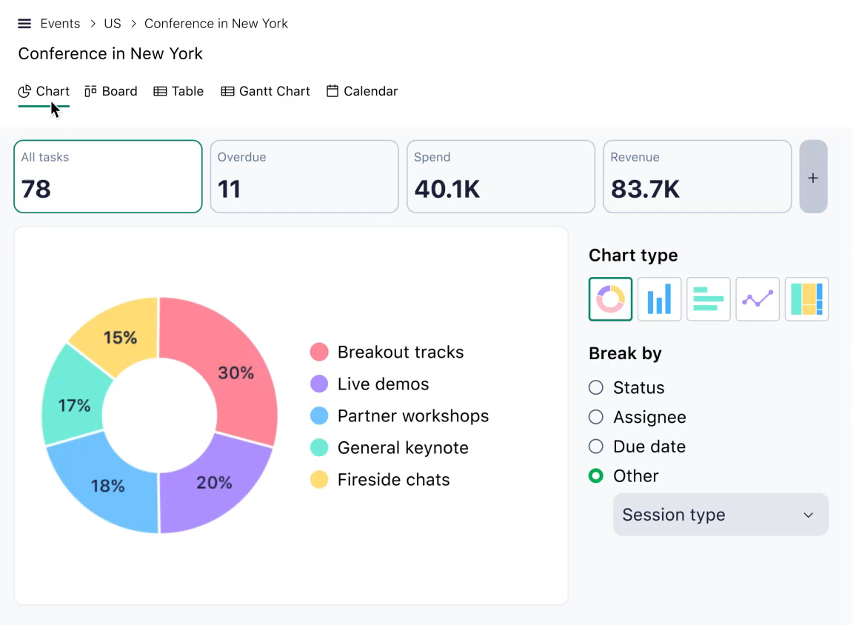
Collaboration Services
Project Management Tools:
Platforms for planning, organizing, and tracking projects, ensuring efficient collaboration and task management.

Slide 66
Communication Services
Voice over IP (VoIP) Telephony
Video Conferencing
Unified Communications (UC)
Web Conferencing
Intercom Systems
Emergency Communication Systems
Ticketing and Help Desk Systems
Status and Dashboard Displays
Communication APIs
Social Intranet Platforms
Alerting and Notification Systems
Collaborative Incident Management

Slide 67
Scalability Services
Virtualization
Auto-Scaling
Load Balancing
Elastic Computing
Container Orchestration
Serverless Computing
Scalable Storage solutions
Scaling Groups
Content Delivery Network (CDN)
Database Sharding
Horizontal Scaling
Vertical Scaling
Microservices Architecture
Hybrid Cloud Integration

Slide 68
Orchestration Tools
Ansible
Chef
Puppet
Terraform
Kubernetes
Docker Swarm
SaltStack
Juju
OpenStack Heat
CloudFormation (AWS)
Azure Resource Manager (ARM)
Google Cloud Deployment Manager
Jenkins
RunDeck

Slide 69
Compliance Management
Regulatory Compliance
Security Standards
Data Classification & handling
Access control policies
Change Management
Incident Response & Reporting
Vulnerability Management
Risk Management
Physical Security Measures
Audit Trails & Logging
Security Awareness training
Configuration Management
Data Retention
Encryption Policies
Compliance Audits
Contractual Compliance
Documentation & Record keeping
Continuous Monitoring & improvement

Slide 70
Governance Policies
Information Security Policy
Access Control Policy
Change Management Policy
Incident Response Policy
Business Continuity & Disaster Recovery Policy
Asset Management Policy
Data Classification & Handling Policy
Acceptable use Policy
Mobile Device Management Policy
Vendor Management Policy
Privacy Policy
Compliance Policy
Network Security Policy
Cloud Governance Policy
Physical Security Policy
Configuration Management Policy
Training And Awareness Policy
Audit and Monitoring Policy
Software Development Lifecycle (SDLC) Policy

